Slide 1
DataSpark: Illuminating Insights for Global Electronics
Problem Statement:
As part of Global Electronics' data analytics team, you are tasked with conducting a comprehensive Exploratory Data Analysis (EDA) to uncover valuable insights from the company’s data. Your goal is to provide actionable recommendations that can enhance customer satisfaction, optimize operations, and drive overall business growth.
Global Electronics, a leading retailer of consumer electronics, has provided you with several datasets containing information about their customers, products, sales, stores, and currency exchange rates. The company seeks to leverage this data to better understand their business and identify areas for improvement.
Presented by:
Arun Raja R G
Batch: MDT40

Slide 2
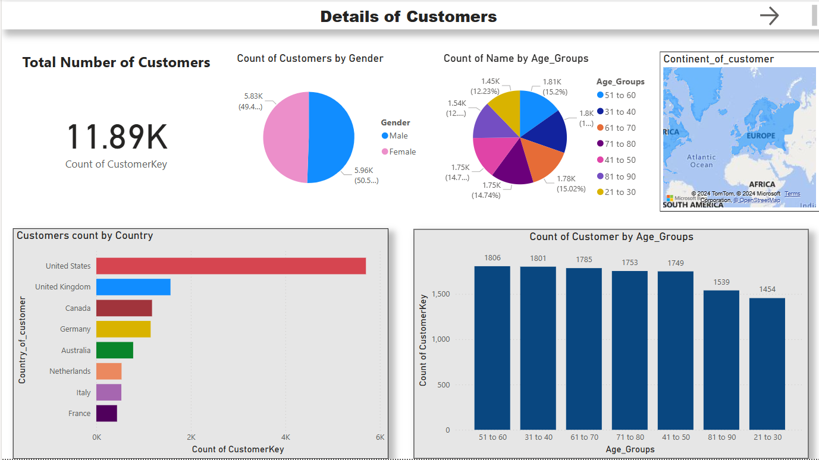

Slide 3
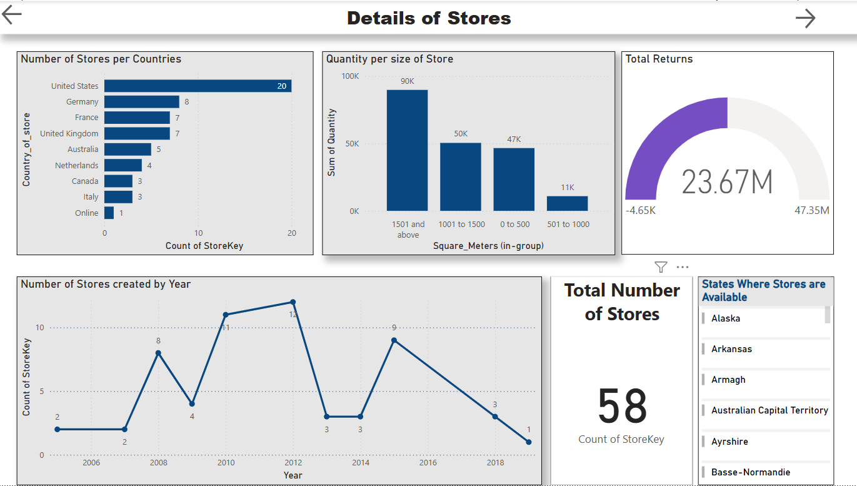

Slide 4
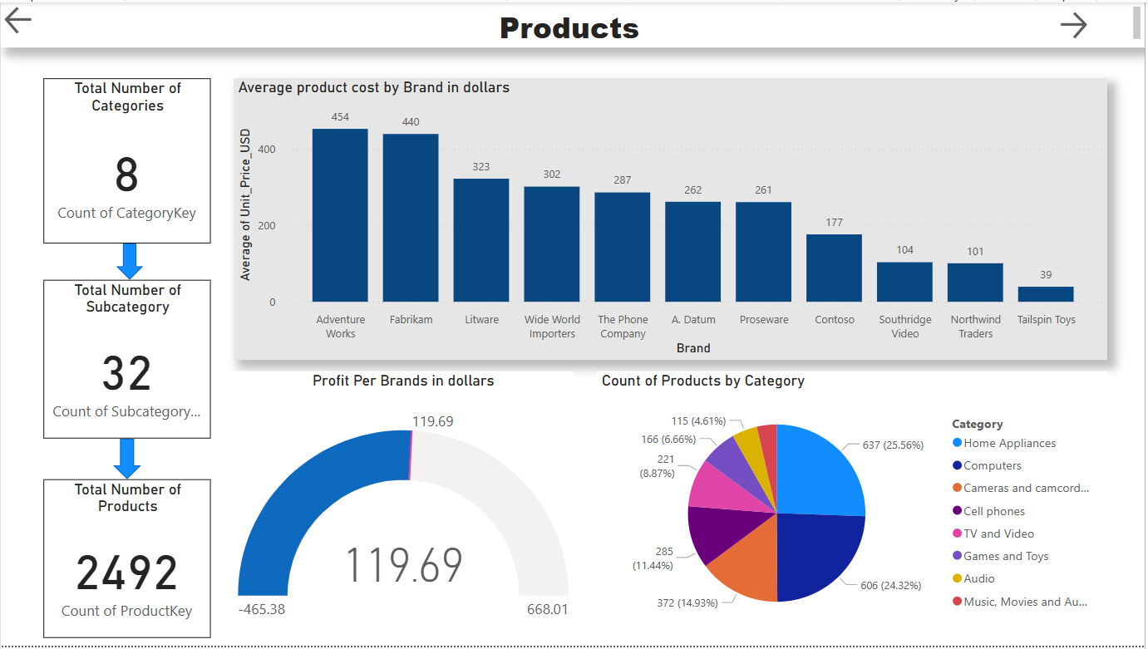

Slide 5
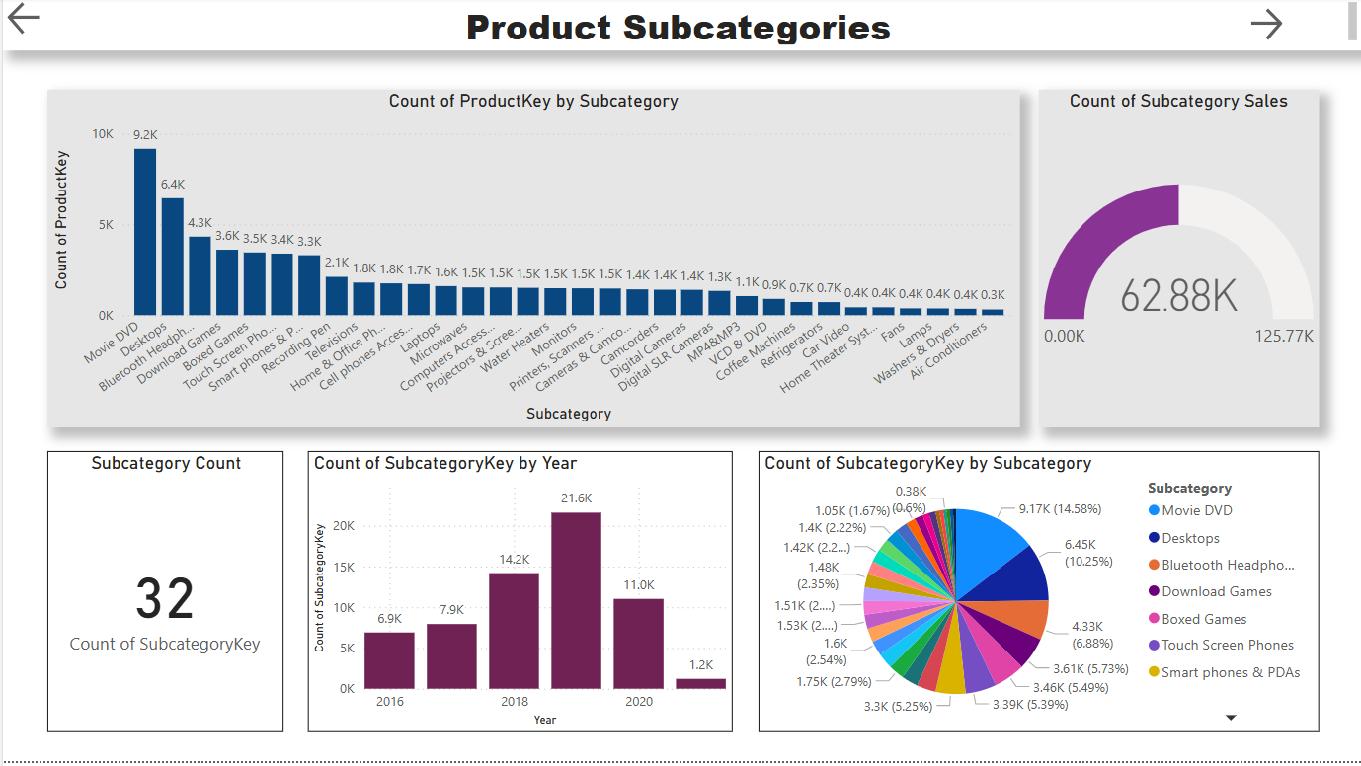

Slide 6
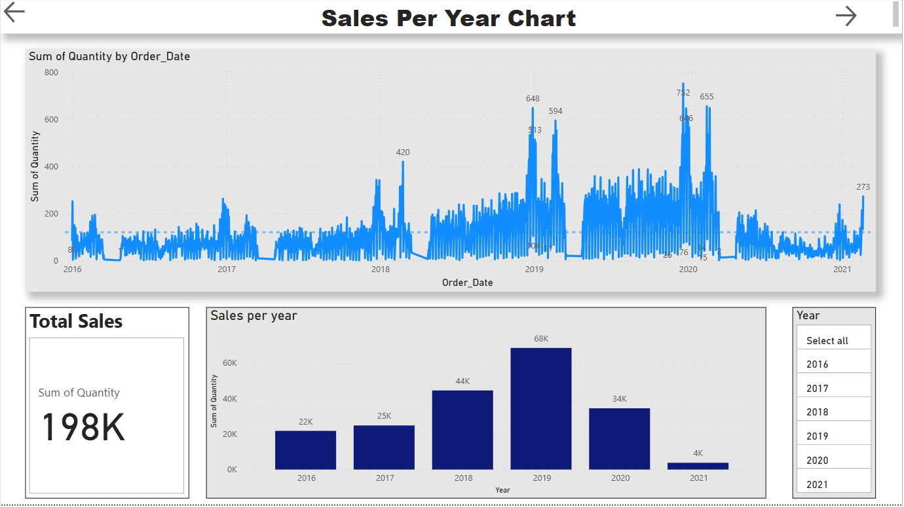

Slide 7
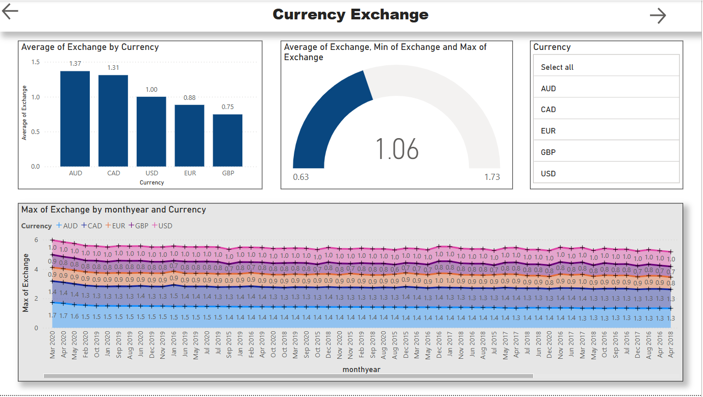

Slide 8
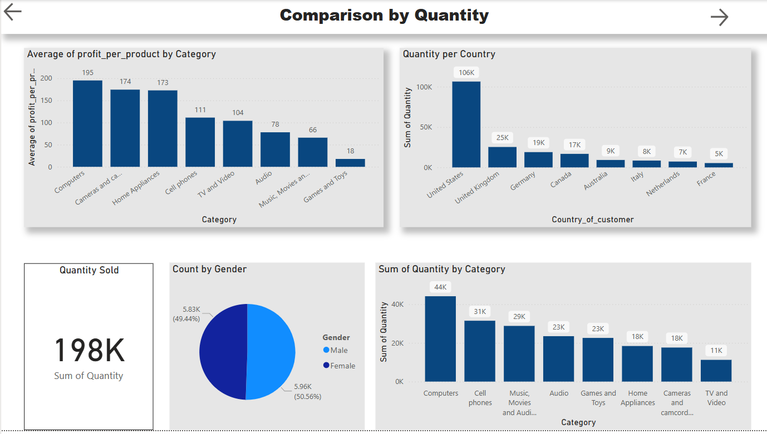

Slide 9
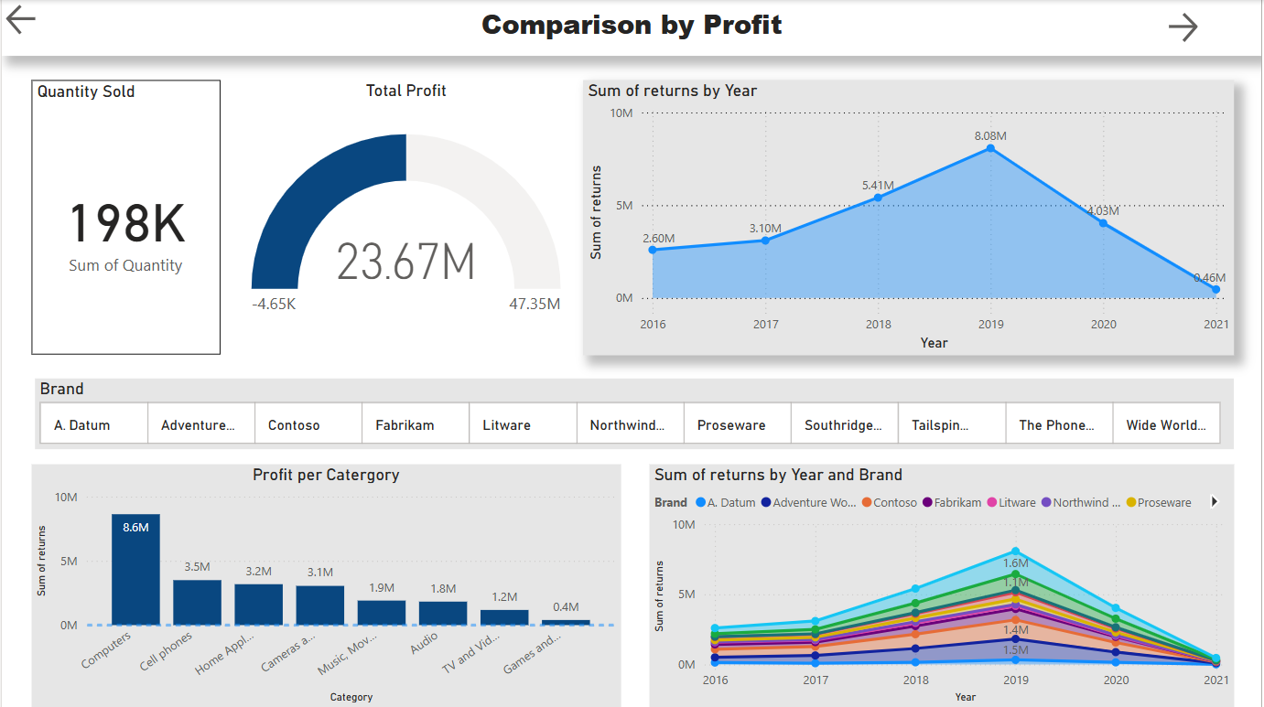

Slide 10
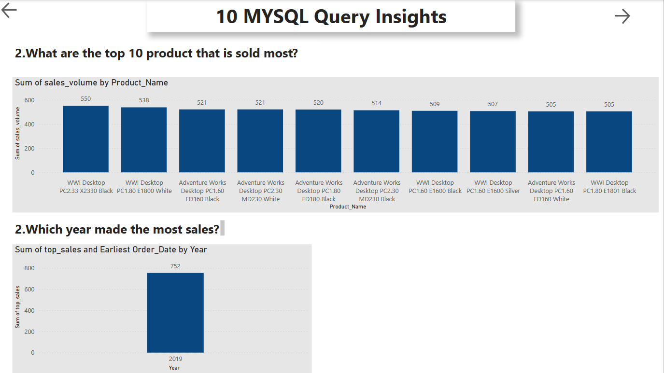

Slide 11
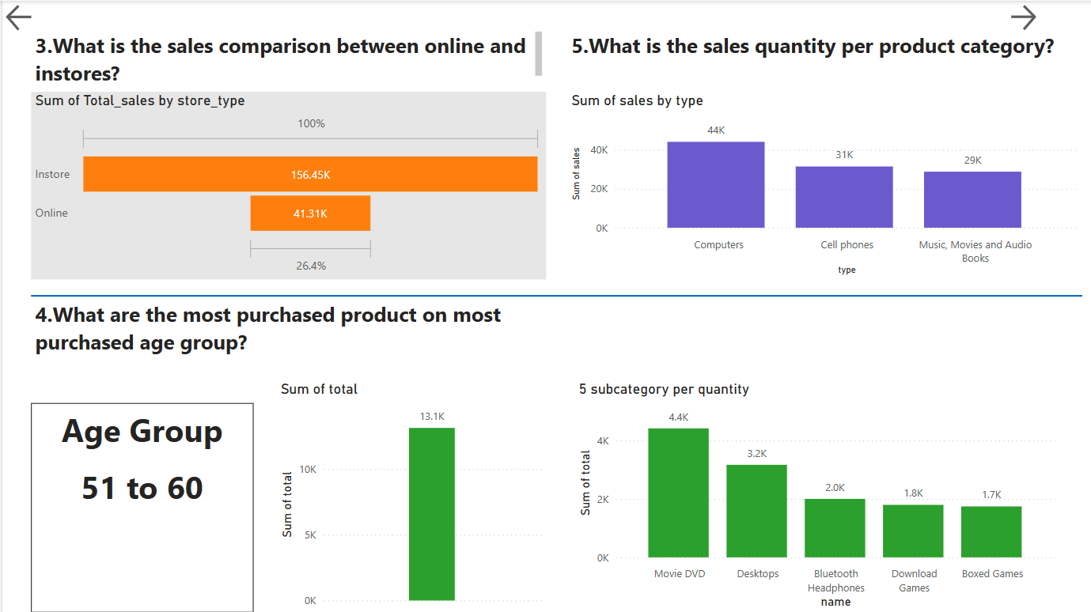

Slide 12


Slide 13
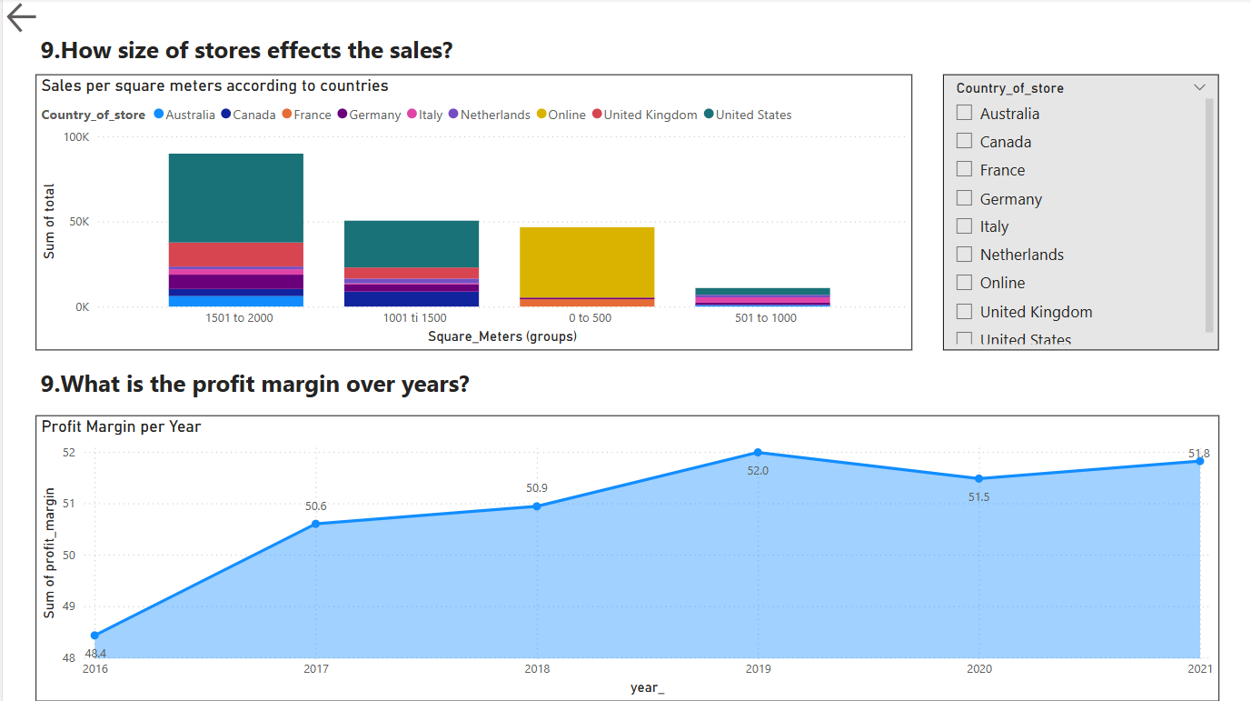

Slide 14
Thank You

